Slide 1
еес EURASIAN
ECONOMIC
COMMISSION
TECHNICAL REGULATION
IN THE CUSTOMS UNION AND
THE COMMON ECONOMIC SPACE
Valery N. Koreshkov
Minister for Technical Regulation
Member of the Board of the Eurasian Economic Commission

Slide 2

Governing Bodies and the structure of the Eurasian Economic Commission
Supreme Eurasian Economic Council
(Heads of States or Heads of Governments of the Parties)
Eurasian Economic Commission
Council (3 Council members - 1 Deputy Prime Minister representing the Government of each Member State)
Board (9 members of the Board - 3 members from each Country – Chairman and 8 Ministers)
Integration and Macroeconomics
Economy and Financial Policy
Competition and Antitrust Regulation
Trade
Advisory Bodies
Technical Regulation
Industry and Agriculture
Energy and Infrastructure
Customs Policy
Departments
Departments
Departments
Consultative Committee for Technical Regulation, Sanitary, Phytosanitary and Veterinary Measures
Department for Technical Regulation and Accreditation
Department for Sanitary, Phytosanitary and Veterinary Measures

Slide 3
еес EURASIAN
ECONOMIC
COMMISSION
Changes to the Single List of Products subject to setting up mandatory requirements within the Customs Union
Approved by Decision №102
of EEC Council dated
23 November 2012
1 object was excluded – alternative types of fuel (line 50)
6 objects were included (line 61 - 66):
Liquefied petroleum gases to be used as fuel
Materials that come in contact with human skin
Products intended for civil protection and defense in emergency situations of natural and anthropogenic character
Oil made ready for transportation and (or) use
Natural inflammable gas made ready for transportation and (or) use
Main pipelines for the transportation of liquid and gaseous hydrocarbons

Slide 4
еес EURASIAN
ECONOMIC
COMMISSION
Development of Customs Union Technical Regulations
Program of development of Customs Union (CU) technical regulations for 2012 – 2013
Approved by Decision of the EEC Council dated 23 November 2012 №103
The development of 13 drafts goes on:
On Safety of pressure equipment adoption
On Safety of meat and meat products adoption
Technical Regulation on milk and diary products adoption
On Safety of buildings and structures, construction materials and articles adoption
On Safety of synthetic detergents and household chemicals adoption
On Safety of paints and coatings adoption
On Requirements to fertilizers adoption
On Safety of chemical products adoption
On Safety of alcoholic products ISC
Technical Regulation on tobacco products ISC
On Safety of fish and fishery products
On Safety of feed and feed additives
On Informing consumers about the energy efficiency of electrical energy consuming devices
stage
Coordination with Parties to send the draft for Internal State Coordination (ISC)

Slide 5
еес EURASIAN
ECONOMIC
COMMISSION
Development of Customs Union Technical Regulations
Program of development of CU technical regulations for 2012 – 2013
Approved by Decision of the EEC Council dated 23 November 2012 №103
Additionally 16 drafts were included:
On Safety of amusement machines
On Requirements to fire safety and fire fighting devices
On Requirements to systems and meters of water, gas, heating energy and electricity
On Requirements to the measuring tools for oil and oil processing products
On Safety of materials that come in contact with food products
On Requirements to the energy efficiency of electrical energy consuming devices
On Safety of equipment used on children’s playgrounds
On Restrictions of the use of dangerous substances in electrotechnical and radioelectronical devices
On Safety of subway rolling stock
On Safety of light railway transport and tramways
On Safety of medical devices
On Safety of poultry and poultry processing products
On Safety of pre-packaged drinking water
On Requirements to the water in terms of systems of purification and conditioning
Requirements to coals and coal processing products
Requirements to liquefied petroleum gases to be used as fuel

Slide 6
Mandatory requirements for children products within the Customs Union and the Common Economic Space
еес EURASIAN
ECONOMIC
COMMISSION
Adopted CU Technical Regulations:
Drafts of the CU Technical Regulations:
On safety of products for children and adolescents
(Decision of the EEC Council dated 23 September 2011 № 797)
based on the Directive 2002/72/ЕС (housewares)
On safety of toys (Decision of the EEC Council dated 23 September 2011
№ 798)
based on the Directives 2009/95/ЕС, 88/378/ЕС, 93/68/ЕС.
On Safety of amusement machines
based on the Directive 98/37/ЕС and EN 13814:2004;
On Safety of equipment used on children’s playgrounds
based on ЕN 1177:1998

Slide 7

Main procedures of drafting technical regulations of the Customs
Union that foresee the involvement of business community.
Provision on the procedure of drafting, adoption, amendment and cancellation of the Customs Union technical regulations.
Approved by the Decision of the EEC Council dated 20 June 2012 №48
The provision sets up procedures with participation of experts:
Development of the technical regulation by a working group
(drafting body, the national standardization body, specialized technical committees on standardization, experts, representatives of industry and business community).
Public discussion for at least 60 days on the official website of the Commission.
Publication of comments (opinions) and suggestions received during the public discussions of the technical regulation draft. It is published by the Commission on the official website for general review.
Two series of discussions at the Consultative Committee meeting (for the purpose of submitting for the public discussion and before submitting for internal state approval).
Assessment of the regulative impact during the process of internal state approval in Parties.
Active participation of experts in drafting of the Customs Union technical regulations makes it possible to respect the interests of all the parties concerned.

Slide 8
Competences of the Eurasian Economic Commission to
adopt technical regulations of the Customs Union.
Decision on adoption and entering into force of CU technical regulations
The COUNCIL of the Eurasian Economic Commission:
– adopts the Customs Union technical regulation;
– defines the date of entering into force of the Customs Union technical regulation.
The BOARD of the Eurasian Economic Commission approves:
Rules of the transition period for:
– products which were previously subject to mandatory conformity assessment
– practice of application of previously issued documents of conformity assessment
– keeping of the existing conformity marking in accordance with the national legislation
– application of methods of measurement of safety indicators
The lists of standards used to:
- fulfill the requirements of technical regulations
- test compliance with the requirements of technical regulations

Slide 9


31 CU Technical Regulations were adopted
8 CU technical regulations CAME INTO FORCE in 2012
Name of technical regulation | № of decision and adoption date | Effective date
«On safety of pyrotechnical articles» | № 770 on August 16, 2011 | 15 February 2012
«On safety of personal protective equipment» | № 878 on December 9, 2011 | 1 June 2012.
«On safety of packaging» | № 769 on August 16, 2011 | 1 July 2012
«On safety of toys» | № 798 on September 23, 2011 | 1 July 2012
«On safety of products for children and adolescents» | № 797 on September 23, 2011 | 1 July 2012
«On safety of perfumes and cosmetic products» | № 799 on September 23, 2011 | 1 July 2012
«On safety of light industry products» | № 876 on December 9, 2011 | 1 July 2012
«On requirements for automobile and aviation gasoline, diesel and marine fuel, jet fuel and mazut heating oil» | № 826 on October 18, 2011 | 31 December 2012

Slide 10
31 CU Technical Regulations were adopted
13 CU Technical Regulations that COME INTO FORCE in 2013
Name of technical regulation | № of decision and adoption date | Effective date
«On safety of low voltage equipment» | № 768 on August 16, 2011 | 15 February 2013
«On safety of equipment intended for use in potentially explosive atmospheres» | № 825 on 18 October 2011 | 15 February 2013
«On safety of machinery & equipment» | № 823 on 18 October 2011 | 15 February 2013
«On safety of lifts» | № 824 оn 18 October 2011 | 15 February 2013
«On safety of equipment using gaseous fuels» | № 875 on 9 December 2011 | 15 February 2013
«On electromagnetic compatibility of technical means» | № 879 on 9 December 2011 | 15 February 2013
«On safety of food products» | № 880 on 9 December 2011 | 1 July 2013
«On safety of grain» | № 874 on 9 December 2011 | 1 July 2013
«Labeling of foodstuffs» | № 881 on December 9, 2011 | 1 July 2013
«On fruit and vegetable juices» | № 882 on 9 December 2011 | 1 July 2013
«On oil and fat products» | № 883 on 9 December 2011 | 1 July 2013
«On safety of some types of specialized food products, including clinical nutrition and dietary preventive nutrition» | № 34 on 15 June 2012 | 1 July 2013
«Safety requirements for food additives, flavorings and processing aids» | № 58 on 20 July 2012 | 1 July 2013

Slide 11
31 CU Technical Regulations were adopted
10 Technical Regulations that will COME INTO FORCE in 2014 - 2015
Name of technical regulation | № of decision and adoption date | Effective date
«On safety of small size vessels» | № 33 on 15 June 2012 | 1 February 2014
«On requirements for lubricants, oils and special liquids» | № 59 on 20 July 2012 | 1 March 2014
«On safety of furniture products» | № 32 on 15 June 2012 | 1 July 2014
«On safety of explosives and products on their basis» | № 57 on 20 July 2012 | 1 July 2014
«On safety of high-speed railway transport» | № 710 on 15 July 2011 | 15 July 2014
«On safety of railway equipment» | № 710 on 15 July 2011 | 15 July 2014
«On safety of railway transport infrastructure» | № 710 on 15 July 2011 | 15 July 2014
«On safety of wheeled vehicles» | № 877 on 9 December 2011 | 1 January 2015
«Road safety» | № 827 on 18 October 2011 | 15 February 2015
«On safety of agricultural and forestry tractors and their trailers» | № 60 on 20 July 2012 | 15 February 2015

Slide 12
Implementation of Requirements of the Customs Union
Technical Regulations
Application of interstate GOST standards common for the Customs Union member states.
THE LISTS OF STANDARDS APPROVED TO SUPPORT
the adopted technical regulations:
List of Standards whose voluntary application ensure compliance with the requirements of the CU technical regulation
about 3000 standards
Lists of Standards that contain rules and methods of research (tests) including rules of sampling necessary for application and fulfillment of requirements of the CU technical regulation and execution of conformity assessment of products
About 4000 standards,
including measurement procedures
Out of 7000 standards - approximately 50% are GOST standards

Slide 13
Introduction of amendments in the Decisions of the CU Commission (predecessor of the Eurasian Economic Commission)
Provision on Conformity Mark for
products being circulated on the markets
of the Customs Union
member states
Amendments were introduced by the Decision of the EEC Council dated 20 June 2012 №48
Products are marked with the Conformity Mark - before being released to the market
The right to affix the Conformity Mark to a product is given to a manufacturer, its authorized representative or an importer
The Conformity Mark should:
- be visible, clear and readable
- avoid misleading consumers about its meaning and image

Slide 14
Cooperation with the CIS countries on technical regulation.
The CIS Agreement on elimination of technical barriers to trade
dated 17 December 2012
Mutual recognition by the Agreement Parties of documents containing the results of conformity assessment of compliance with the requirements of the Customs Union technical regulations
Performing the procedures of public discussion of draft Customs Union technical regulations by the competent authority of the interested state
Assessment of conformity with requirements of the Customs Union technical regulations which is performed on the territory of the interested state
Including accredited certification bodies and testing laboratories (centres) of the interested state in the Single list of the Customs Union
Affixing the Conformity Mark to products circulated on the market of the Customs Union member states
Implementation of the Agreement’s provisions will facilitate mutual trade between the Customs Union member states and the CIS countries

Slide 15
Customs Union Technical Regulation «On Safety of Toys» -
TR TS 008/2011
Entered in force
on 1 July 2012
Approved by the Decision of CU Commission № 798 dated 23 September 2011
CU TR sets up common requirements for toys that are mandatory for application and fulfillment on the CU territory
End of transition period | 15 February 2014
End of period of validity of documents on conformity assessment (assurance) proving compliance with mandatory requirements of the CU or CU member states | 15 February 2014
End of manufacturing and release into circulation of products that comply with earlier mandatory requirements | 15 February 2014
Circulation of products that were put into circulation during the period of validity of documents on conformity assessment (assurance) proving compliance with mandatory requirements of the CU or CU member states | During the life time of products
Type of conformity assessment | Schemes (in accordance with the conformity assessment types
Certification | For serial production 1с – evaluation of production, tests
 | 2с – without evaluation of production if the manufacturer has a certified system of quality management, tests
 | For batch of products (single product) 3с – tests

Slide 16
List of measures that are necessary to implement the CU TR «On
Safety of Toys»
Approved by the Decision of the Board dated 5 April 2012 № 22
Common measures of EEC and the member states of the CU and CES that target the implementation of the technical regulation:
APPROVED:
Program of developing (amending, reviewing) interstate standards
(Decision of EEC Board dated 12 December 2012 № 275);
Amendments to the Lists of Standards
(Decision of EEC Board dated 12 December 2012 № 276);
Amendments to the Single List of Products subject to mandatory conformity assessment adopted by the Decision of the CU Commission dated 7 April 2011 № 620 (Decision of EEC Board dated 13 июня 2012 № 80);
Amendments to the Common sanitary, epidemiological and hygienic requirements
(Decisions of EEC Board dated 19 April 2012 № 34 and dated 23 August2012 № 141).
PREPARED:
List of products (articles) in respect of which Customs Declaration is accompanied by a conformity assessment document proving compliance with the requirements of the technical regulation (is envisaged to be analyzed by the EEC Board on 31 January 2013)
Drafts of temporary annexes to the technical regulation containing methods of sectoral/trade (institutional) research (testing) and measurements that can be applied until corresponding interstate standards are adopted.
Measures of implementation of the technical regulation in CU and CES member states:
Bringing legal acts in line with the technical regulation;
Enforcement at national level of national (state) standards of other states that are included in the Lists of Standards;
Accreditation (broadening of the accreditation scope) of certification bodies and testing laboratories (centers) that carry out the conformity assessment of products;
Identification of bodies of state control (surveillance).

Slide 17
Customs Union Technical Regulation «On Safety of Toys» -
TR TS 008/2011
CU TR requirements do not cover:
1. Christmas-tree decorations, artificial Christmas-trees and their accessories, Christmas lights.
2. Scale models for collecting not suitable for children under 14 years old.
3. Equipment for children's playgrounds.
4. Sports equipment, including underwater.
5. Folk and decorative dolls not intended for children under 14 years old.
6. "Professional" toys located in public spaces for general use.
7. Playing slot-machines.
8. Puzzles containing more than 500 details.
9. Air guns.
10. Catapults and throwers.
11. Projectiles with metal tips.
12. Transformers for power-supplied toys, chargers for rechargeable batteries, including those supplied with the toy.
13. Items containing heating elements and intended for use in educational processes under the supervision of adults.
14. Vehicles intended for children under 14 years of age with internal combustion engines.
15. Toy cars with steam engines.
16. Bicycles intended for transportation on roads of general use.
17. Toys and games functioning at a nominal voltage of over 24 V.
18. Fire-arms replicas.
19. Imitation jewelry for children.
20. Swimming equipment (e.g., inflatable arm floats).
21. Protective means (goggles, sunglasses, bicycle helmets, skateboarding helmets).
22. Flying toys launched by the child by means of a rubber cord.
23. Bows the length of which exceeds 1200 mm when loosed.
24. Sanitary items made of latex, rubber and silicone elastomers for children.

Slide 18
Lists of Standards whose application ensure compliance with the requirements of
CU Technical Regulation «On Safety of Toys» -
TR TS 008/2011
Amendments to the Lists of Standards
introduced by Decision of EEC Board dated 12 December 2012 № 276
List of Standards whose voluntary application ensure compliance with the requirements of the CU technical regulation | 16 standards 3 GOST 6 STB 3 ST RK 4 GOST R
List of Standards that contain rules and methods of research (tests) including rules of sampling and that necessary for application and fulfillment of requirements of the CU technical regulation and execution of conformity assessment of products | 24 standards, 109 МВИ 14 GOST 4 STB 3 ST RK 3 GOST R
Program
of development (amendment and review) of interstate standards
to the CU TR «On Safety of Toys»
(approved by Decision of EEC Board dated 12 December 2012 №275)
Number of GOST standards Included in the Program | out of which GOST standards that were Developed on the basis of ISO, IEC, EN
9 | ISO – 2 , IEC – 2, EN – 5
The implementation of the program will allow:
Update the list of standards;
Ensure the safety requirements that are put forth to toys by the CU TR and interstate standards that are necessary to be applied;
Increase the number of interstate standards that are contained in the List of Standards.
.
www.eecommission.org

Slide 19
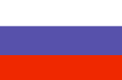
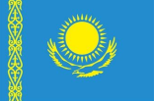
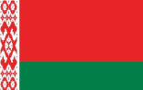
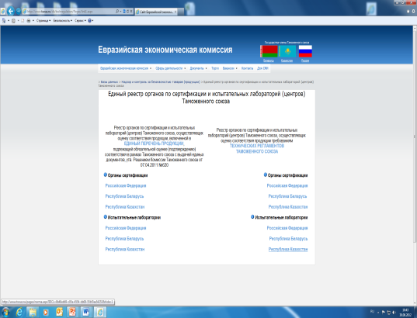
Implementation of conformity assessment in
the Customs Union and Common Economic Space
Accreditation Body
Accreditation Body
Accreditation Body
CU TR
CU TR
CU TR
73
31
28
1024
Certification
Bodies
Certification
Bodies
Certification
Bodies
105
55
1688
Testing
Laboratories
479
Testing
Laboratories
385
Testing
Laboratories
39
42
47
www.fsa.gov.ru
www.nca.kz
www.bsca.by
For the purpose of conformity assessment of compliance of products with the requirements of Customs Union Technical Regulation «On Safety of Toys» TR TS 008/2011 the Unified Register of certification bodies (CB) and testing laboratories (TL) of the Customs Union contains:
More than 1500 certificates of compliance with the requirements of Customs Union Technical Regulation «On Safety of Toys» TR TS 008/2011 were issued.
RB | RK | RF | total
CB – 7 TL – 15 | ОС – 5 ИЛ – 23 | ОС – 35 ИЛ – 18 | ОС – 47 ИЛ – 56
www.eecommission.org

Slide 20
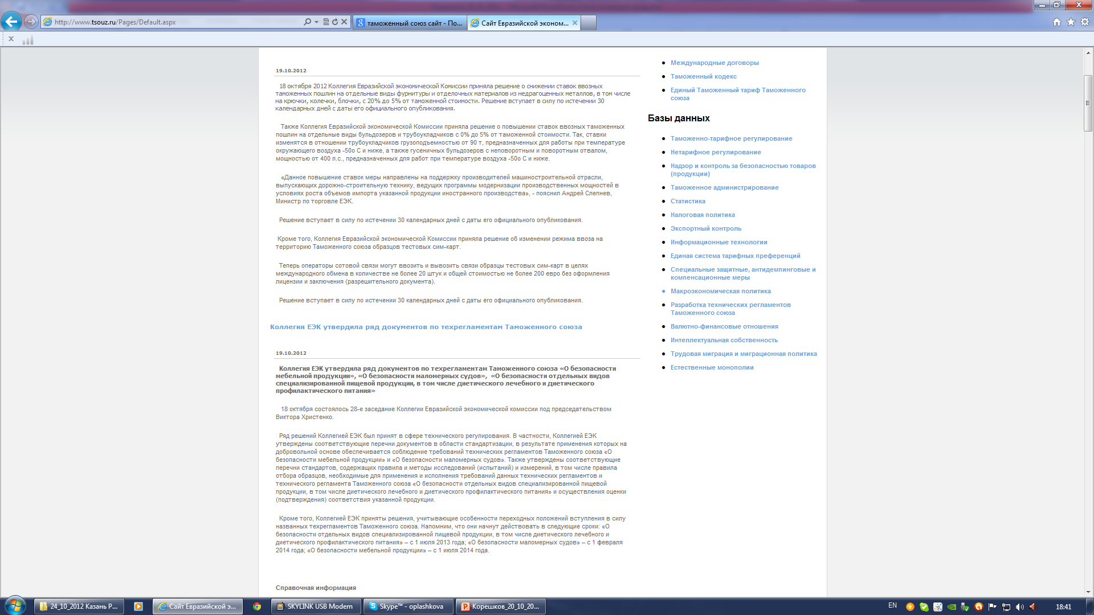
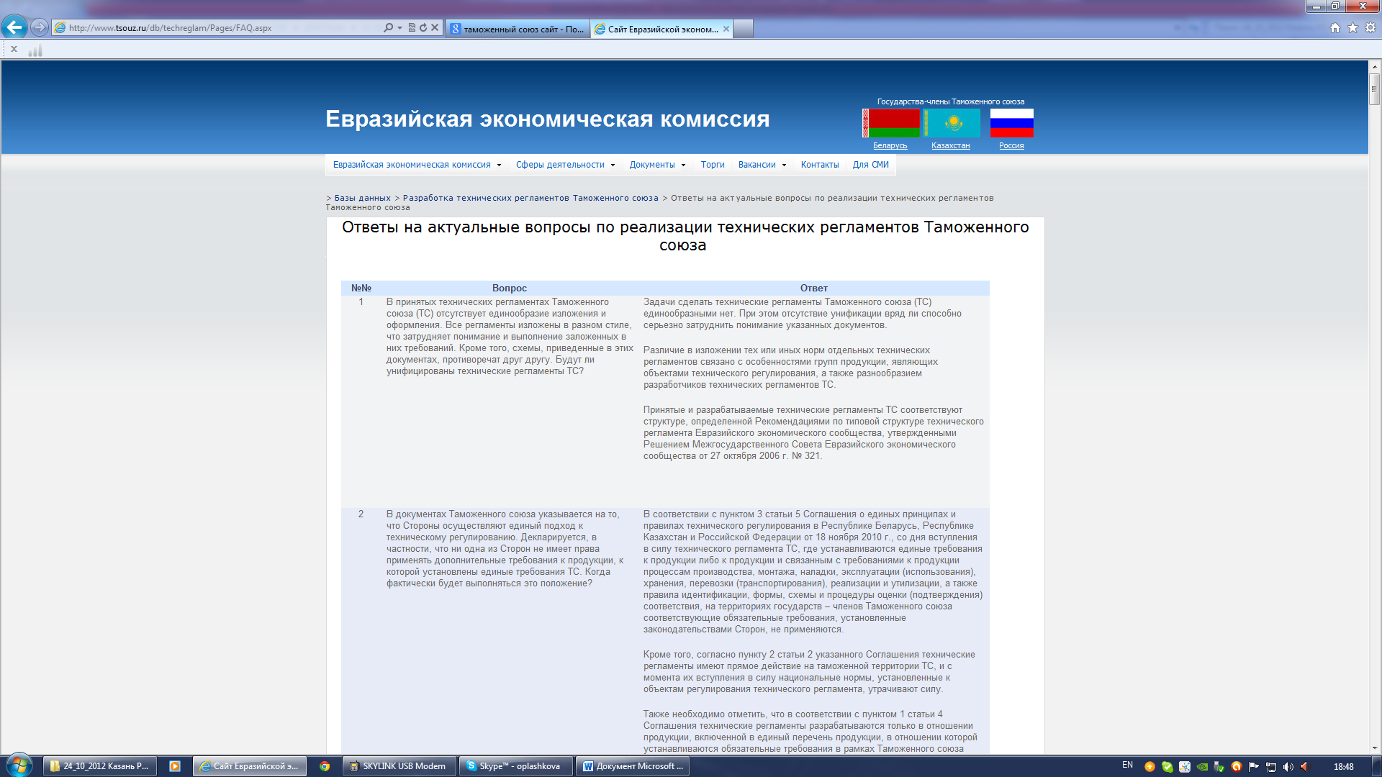
еес EURASIAN
ECONOMIC
COMMISSION
Information Support
Section: Surveillance and Control of Product Safety
Technical Regulation
Sanitary Measures
Veterinary Measures
Plant Quarantine
Unified Register of certification bodies and testing laboratories (centers)
Unified Register of certificates of conformity and registered declarations of conformity
Section: Development of the Customs Union Technical Regulations
Regulatory documents
Technical regulations
Draft technical regulations that were introduced for public discussion and internal state coordination
Draft amendments to technical regulations that were introduced for public discussion and internal state coordination
Answers to topical questions on the implementation of technical regulations
www.eecommission.org

Slide 21
Thank you for attention !
Moscow, Yakovoapostolsky pereulok, 12 bld. 1,
+7 (495) 669-24-00, ext. 5101
E-mail: vnkpr@eecommission.org
www.eecommission.org

